Slide 1
Progress Report on
K-GMT & KMTNet
Ho-Il KIM
2011.11. 08.
5th EACOA Kyoto

Slide 2
Contents
1. K-GMT in 2011
K-GMT Project
GMT : Off-Axis Primary #1
GMT1 Surface Maps
Primary Mirror Covers
1st Generation Instruments
Instrument Mounting
GMT : Preparation to PDR
Community-wide Science Promotion
Preparation for GMT era in KASI
K-GMT 2011 : Data Center
FSM prototype development
GMTNIRS
2. KMTNet in 2011
KMTNet Project
Sciences
Main Science
Telescope
Detector
Filter Changer and Shutter
Wide-field Photometric Systems
Buildings
KMTNet Sites
Project Schedule
5th EACOA Kyoto

Slide 3
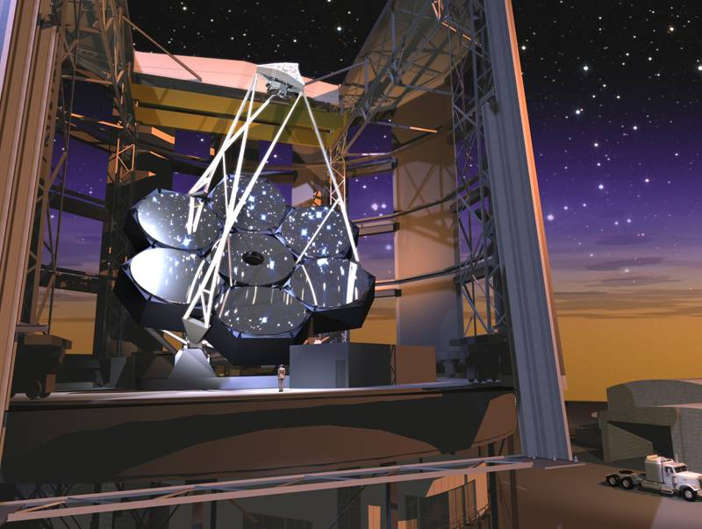
K-GMT in 2011
Overview of K-GMT Project in 2011
5th EACOA

Slide 4
K-GMT Project
Period : 2009 ~ 2018
Budget : USD74M + KRW16.9B
Project Goals :
Acquire 10% share of GMT
Science Promotion for GMT era
Engineering development in high-precision optics/optomechanics
- Fast Steering Secondary Mirror development
- GMT instrument development (GMTNIRS)
Overview of K-GMT Project in 2011
5th EACOA

Slide 5
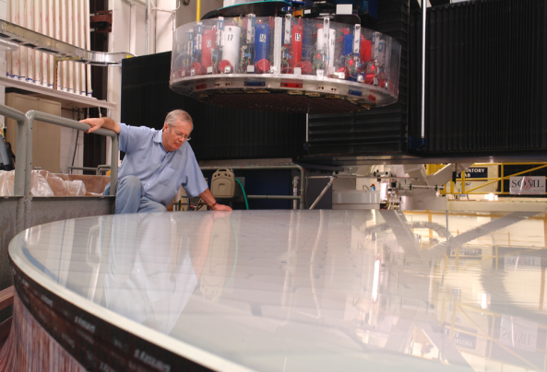
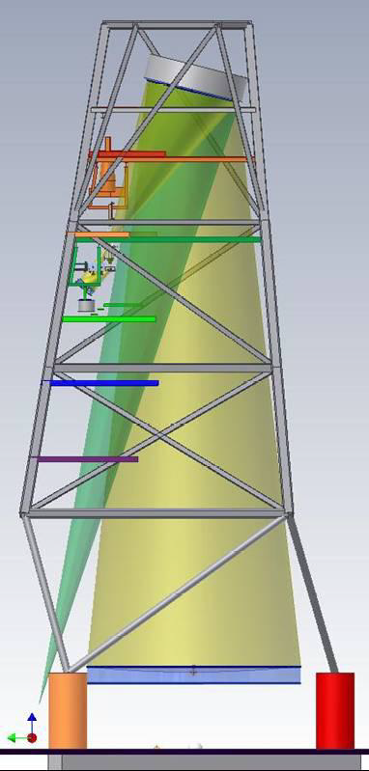
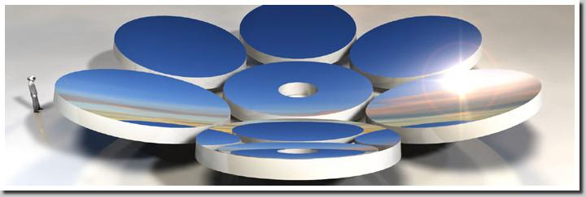
GMT : Off-Axis Primary #1
Development at SOML / Univ. Arizona
Fabrication finish in Nov. 2011
Most pacing item of GMT development
GMT PM#2 casting : Jan. 2012
GMT PM#3 casting : Feb. 2013
Overview of K-GMT Project in 2011
5th EACOA

Slide 6
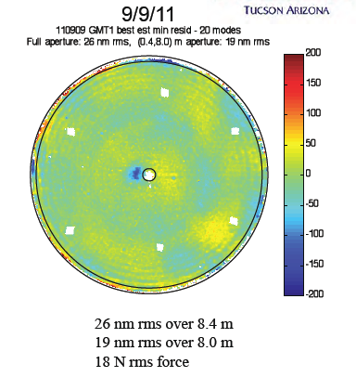
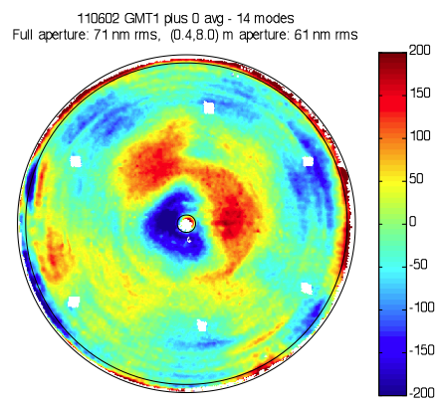
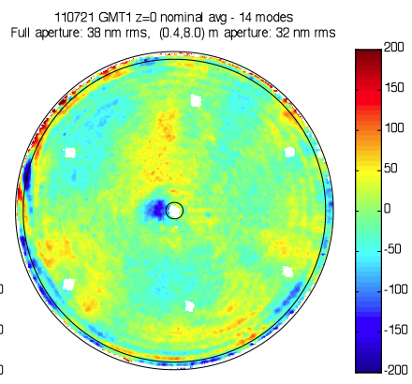
GMT#1 Surface Maps
71 nm
38 nm
June
August
September
Overview of K-GMT Project in 2011
5th EACOA

Slide 7
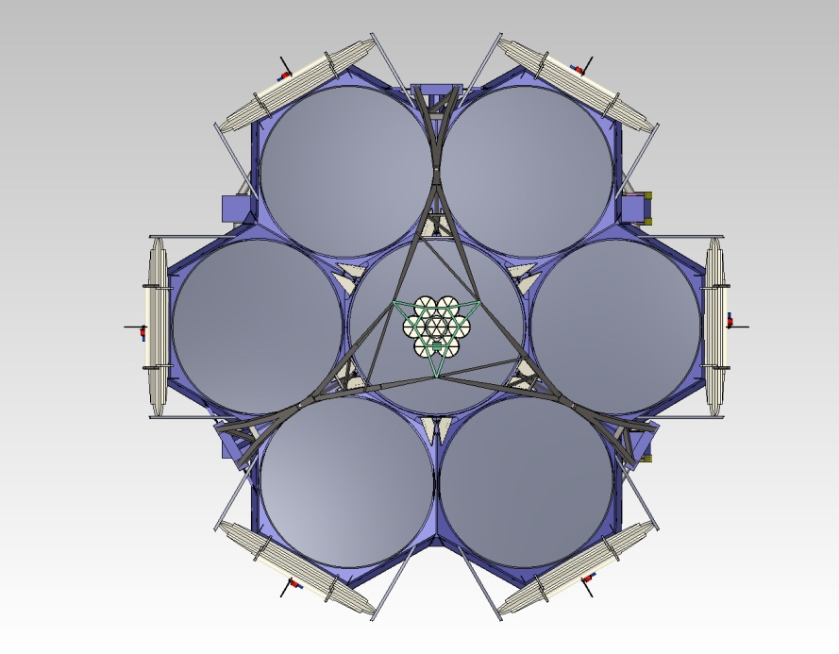
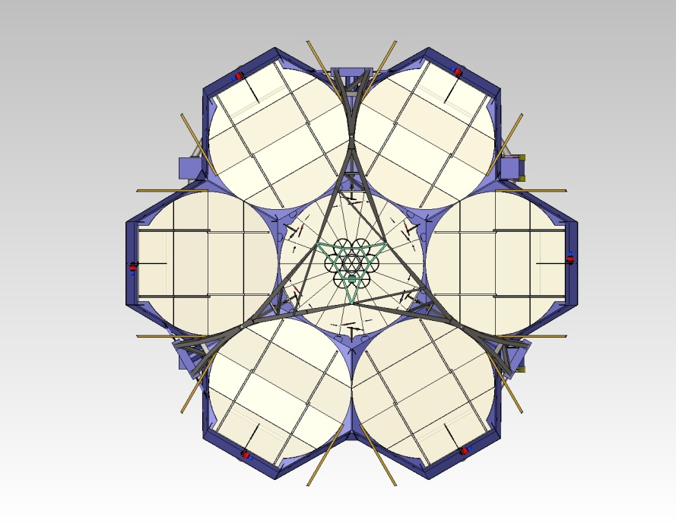
Primary Mirror Covers
Mirror covers clear the beam – even for the center segment!
The only ELT having mirror covers
Overview of K-GMT Project in 2011
5th EACOA

Slide 8
1st Generation Instruments
6 candidates : conceptual studies reviewed
2011. 9. 8. ~ 2011. 10. 7.
Instrument Development Advisory Panel organized
2-4 instruments will be selected before end of 2011
Overview of K-GMT Project in 2011
5th EACOA

Slide 9
1st Generation Instruments
Name | Function | Remark
GMACS | Wide field multi-object optical spectrograph | Non AO
NIRMOS | NIR multi-object spectrograph | Non AO
GMTIFS | Integral-Field spectrograph | Non AO
GMTNIRS | High-Resolution NIR/MIR spectrograph | AO
GCLEF | High dispersion, high stability optical spectrograph | AO
TIGER | MIR Infrared imager | AO
Overview of K-GMT Project in 2011
5th EACOA

Slide 10
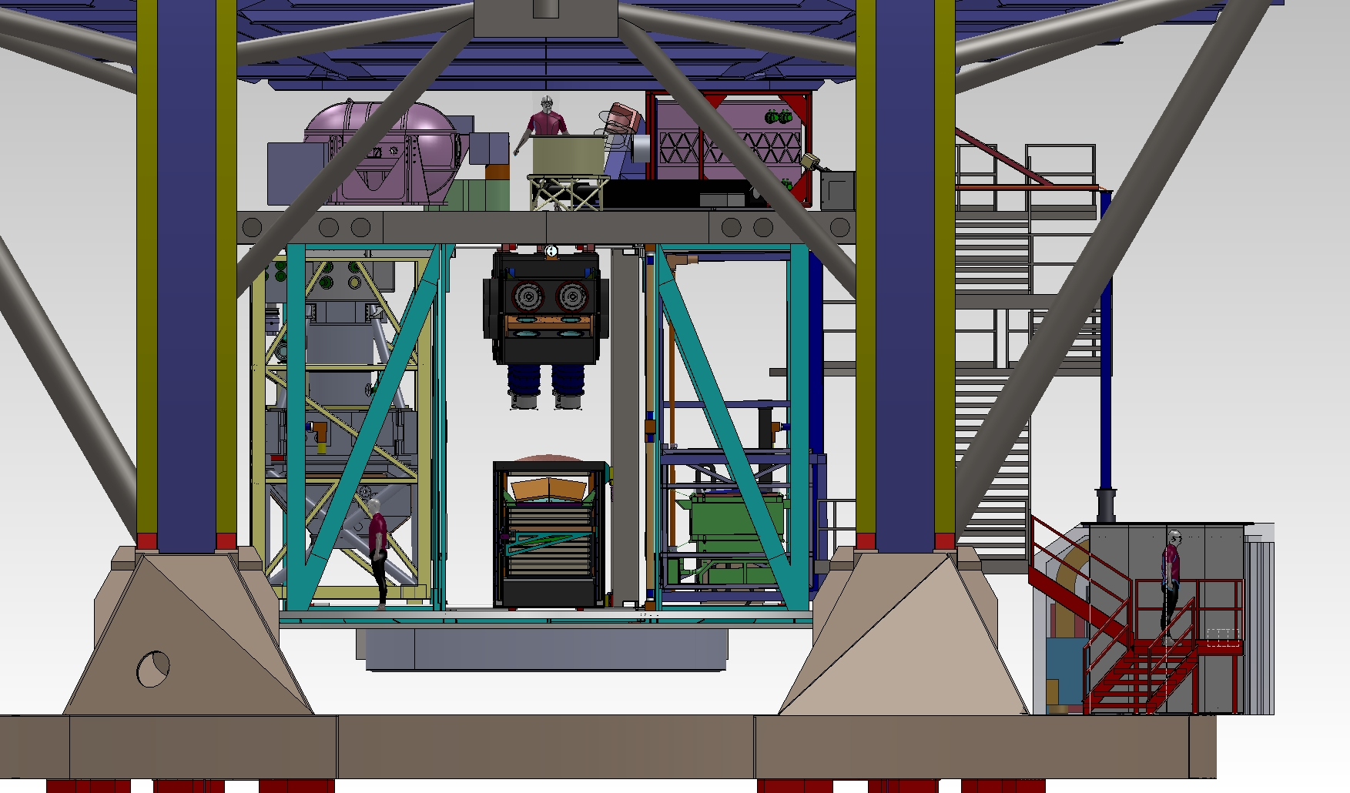
Instrument Mounting
GMTNIRS
GMTIFS
TIGER
NIRMOS
GMACS
G-CLEF
Overview of K-GMT Project in 2011
5th EACOA

Slide 11
GMT : Preparation to PDR
PDR plan : the end of 2012
Science case update will be completed soon or later
1st gen. instruments will be selected in this year
Conceptual design contract for major parts
Enclosure / facilities
Site preparation
Bearings / linear drives
Data Archives and data center
Overview of K-GMT Project in 2011
5th EACOA

Slide 12
Community-wide Science Promotion
K-GMT Science & Instrument working group
15 members
- 10 professors from Universities + 5 KASI members
Internal activities
- Host international workshop
- Summer / winter school on GMT science cases
International collaboration
- Participate in science working group for 1st generation instrument candidates
- Working as panelists to review and select 1st generation instruments
- Participate in the science cases update work
Overview of K-GMT Project in 2011
5th EACOA

Slide 13
Community-wide Science Promotion
New positions in KASI GMT group
KASI-Carnegie fellowship : one postdoc started works
Two more postdocs hired in 2011
Total 6 postdocs working in K-GMT group
KASI endeavors to hire more and more young researchers
Overview of K-GMT Project in 2011
5th EACOA

Slide 14
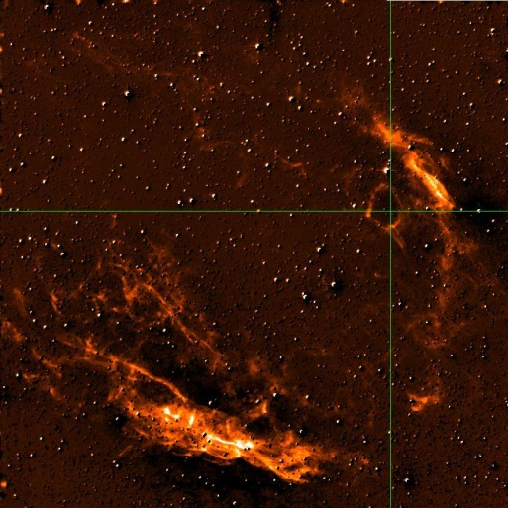
Preparation for GMT era in KASI
Two research groups
GEMS0 : Star formation in the Galaxy
- Using AAT 3.9m telescope, planning UKIRT 4m
DREAM : Galaxy formation and evolution in cluster of galaxies
- Used CFHT 3.6m and Magellan 6.5m this year
Both groups collaborate actively with Universities
Overview of K-GMT Project in 2011
5th EACOA

Slide 15
K-GMT 2011 : Data Center
GMT Data Center Conceptual study
Need to consider how to deal with the data from various instruments
Need to prepare for mirror servers in partner institutions, especially for
Korea and Australia
International Collaboration
Members : Harvard CfA, KASI, ANU, AAL
Period : Sep. 2011 – Jun. 2012
Overview of K-GMT Project in 2011
5th EACOA

Slide 16
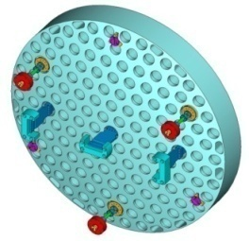
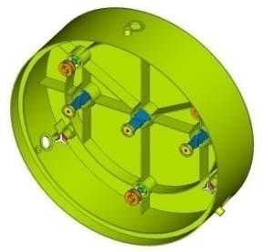
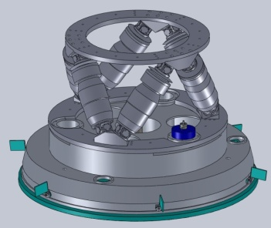
FSM prototype development
FSM : conventional secondary mirror for GMT
International and domestic collaboration
KASI-NOAO (design and development)
KASI-KRISS-GIST-IAE-SELAB
MRR : Sep. 22-23, 2011
TRR : Mar. 2012
Prototype Completion : End of 2012
Overview of K-GMT Project in 2011
5th EACOA

Slide 17
GMTNIRS
KASI-UT Austin collaboration
A high resolution NIR spectrograph using Silicon Immersion Grating
Simultaneous observation in JHK – LM bands.
One of 1st GMT generation instrument candidates
Conceptual design review Oct. 3-4 : passed
Final selection in this year as a 1st generation instrument
Overview of K-GMT Project in 2011
5th EACOA

Slide 18
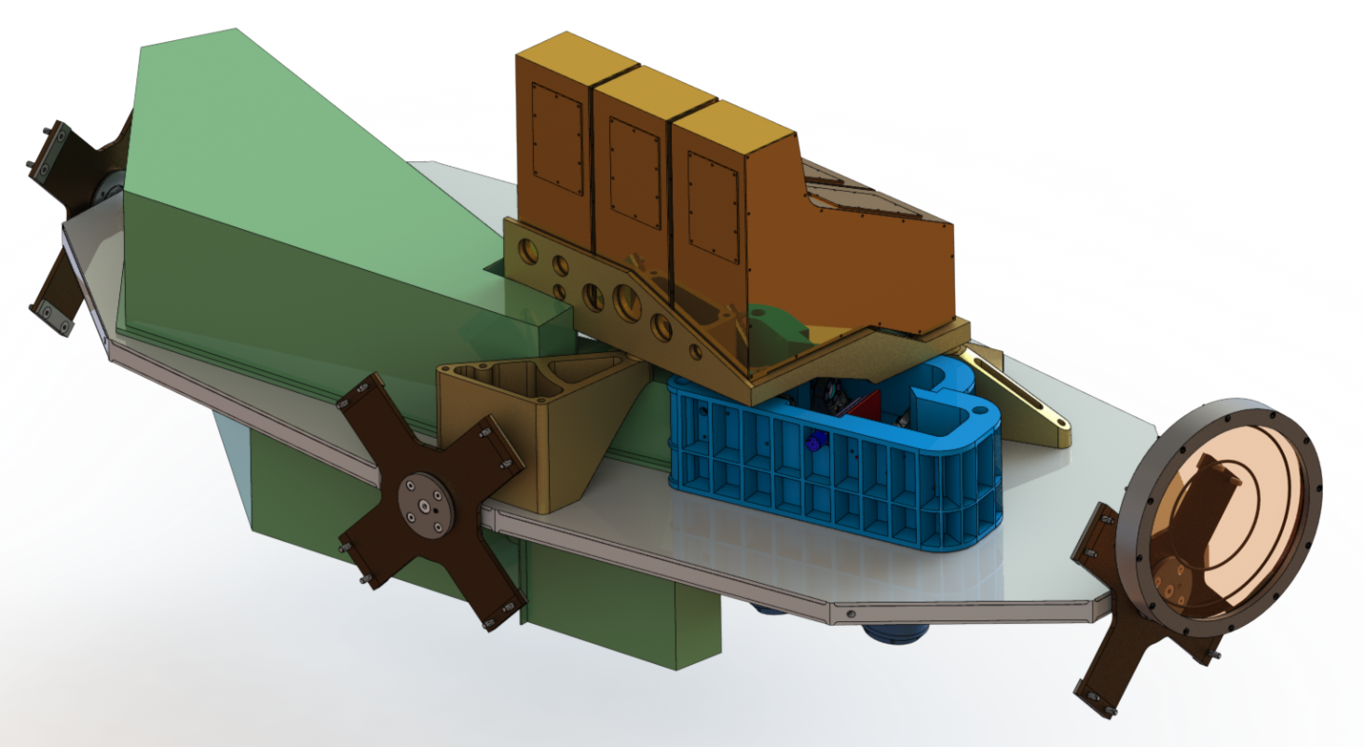
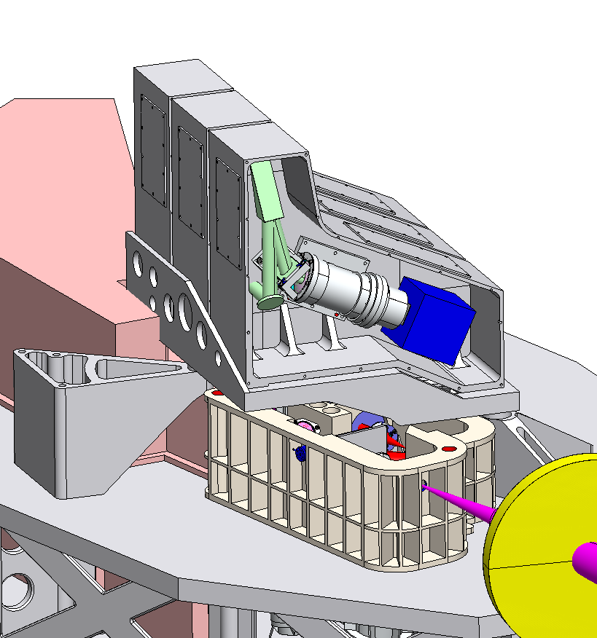
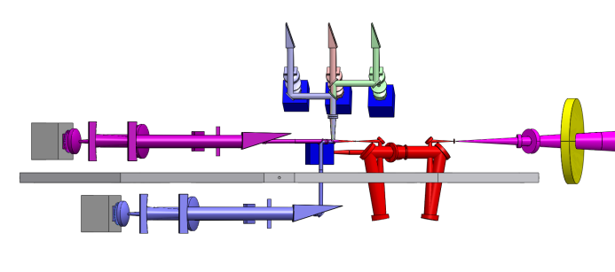
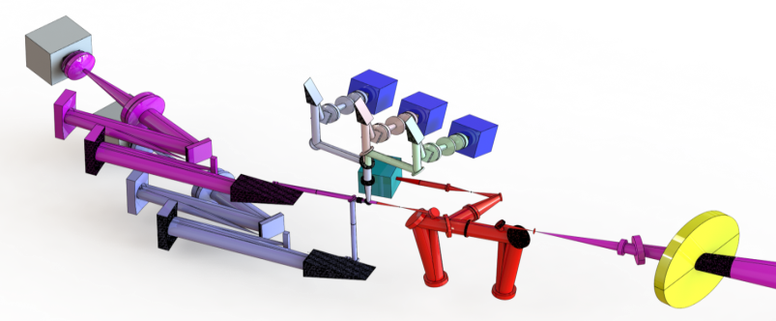
GMTNIRS
M-band spectrograph shield
JHK-band spectrograph Modules
Slit/OIWFS housing
LGS pickoff mirror
L-band spectrograph shield
Overview of K-GMT Project in 2011
5th EACOA

Slide 19
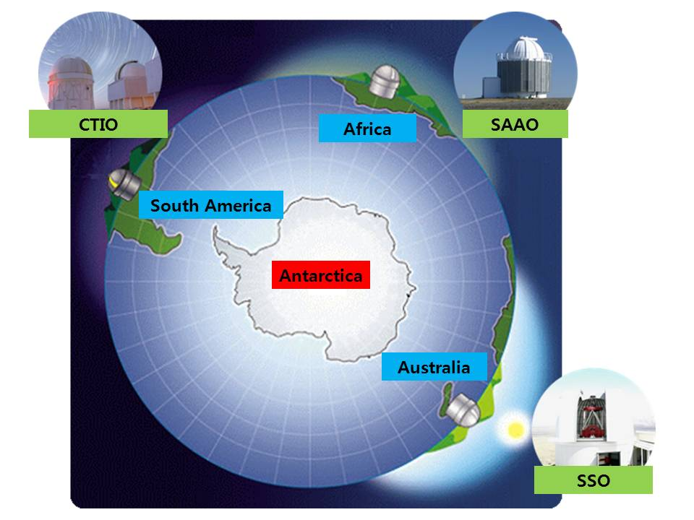
KMTNet in 2011
Overview of KMTNet Project in 2011
5th EACOA

Slide 20
KMTNet Project
Period : 2009 ~ 2018
Budget : KRW30B(~USD26M)
Development of the KMTNet System
Korea Micro-lensing Telescope Network
Three Identical Observing Systems
Will be installed at CTIO in Chile, SAAO in South Africa, and
SSO in Australia by the middle of 2014
24-hours uninterrupted Monitoring of night sky at Southern Hemisphere
Overview of KMTNet Project in 2011
5th EACOA

Slide 21
Sciences
Wide-field Photometric Monitoring
Search for Extra-solar Planets, especially, Earth-mass Planets
in the Habitable Zone, using the micro-lensing technique
Wide-field Photometric Surveys
Surveys of Transiting Planets and Variable Objects
Surveys of Clusters, Galaxies, SNs, Near-Earth Objects, etc.
Overview of KMTNet Project in 2011
5th EACOA

Slide 22
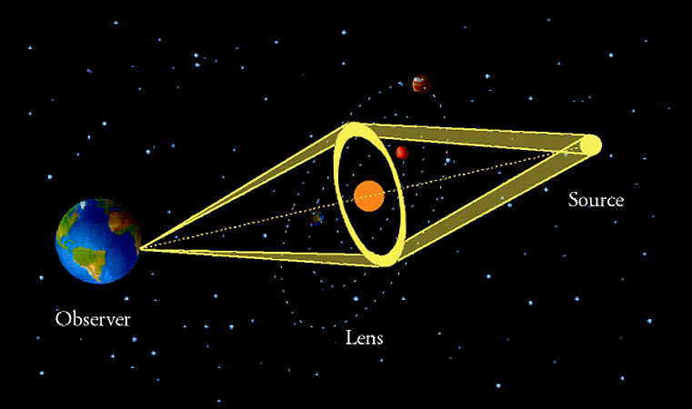
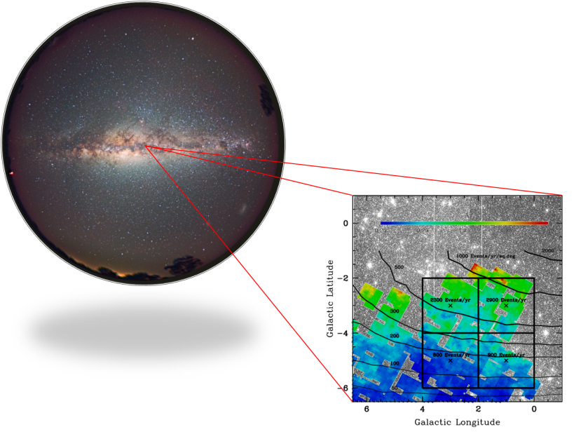
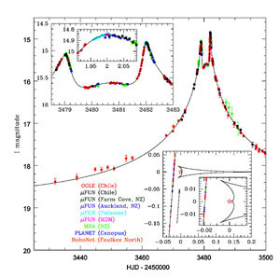
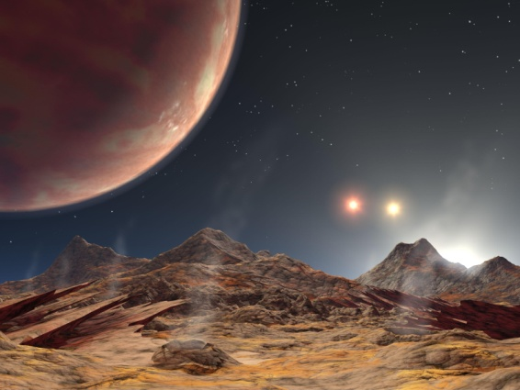
Main Science
Monitoring the Galactic Bulge
Detection of micro-Gravitational Lensing events
Discovery of extra-solar planets
Overview of KMTNet Project in 2011
5th EACOA

Slide 23
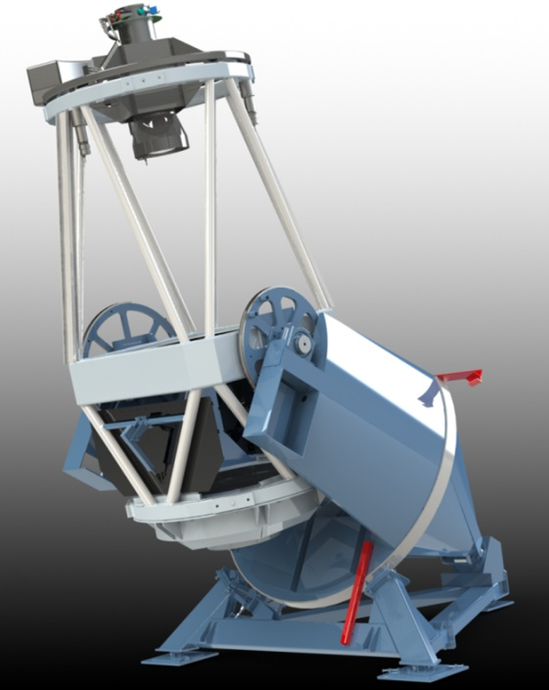
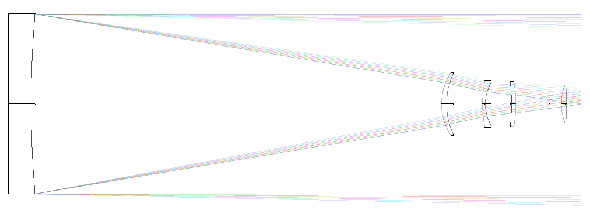
Telescope
Wide Field Optical Telescope
Primary Mirror with 1.6m Diameter
Prime Focus type Reflector
Equatorial Mount
FOV of 2º
Four Field Corrector Lenses
Delivered Image Quality of 1.0” FWHM under
0.75” seeing
Overview of KMTNet Project in 2011
5th EACOA

Slide 24
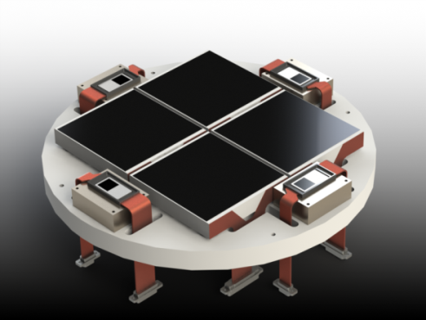
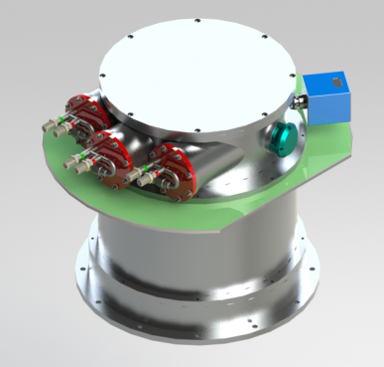
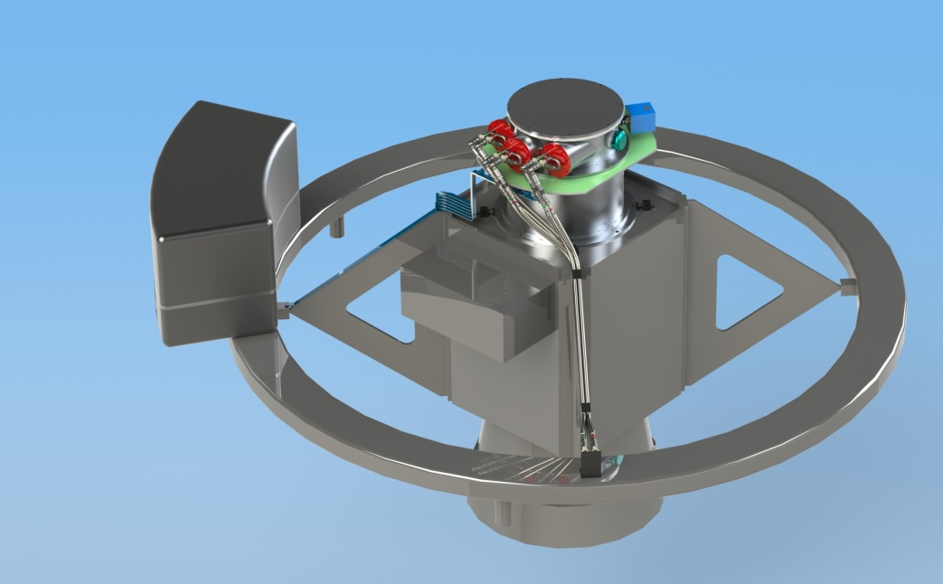
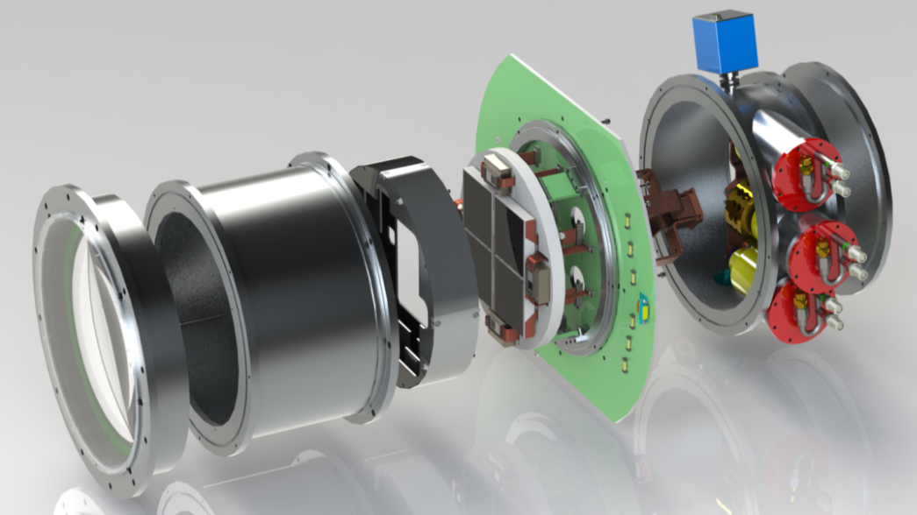
Detector
Large-Format Mosaic CCD camera
Four e2v chips with 9k by 9k pixels
10x10 microns pixel
0.4”/pixel. 2x2 deg. sq. FOV
High Quantum Efficiency of ~90%
Cryogenic Cooling System
Overview of KMTNet Project in 2011
5th EACOA

Slide 25
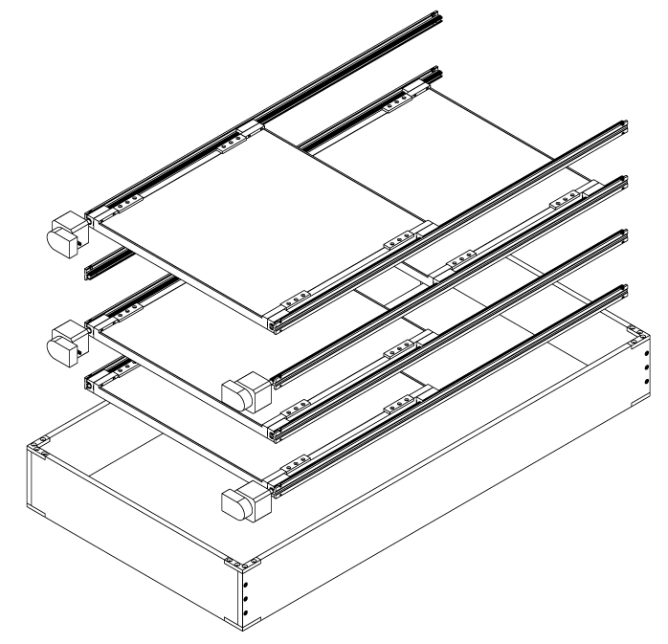
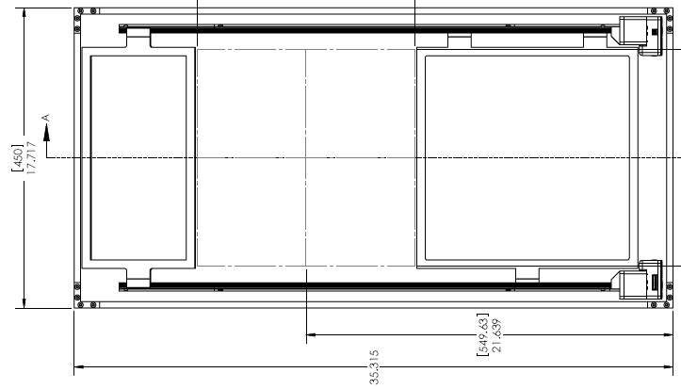
Filter Changer and Shutter
Cassette-Style Filter Changer
Four Spectral Filters with 310x310mm square
Johnson-Cousins BVRI and SDSS griz filter sets
Bonn-Style Shutter
Sliding Shutter with 325x325mm square Clear Aperture
Overview of KMTNet Project in 2011
5th EACOA

Slide 26
Wide-field Photometric Systems
Telescope | Camera | FOV | Site | Target
PanSTARRS 4x1.8m | 1400M pixel CCD | 7.0 deg² | Haleakala, USA | All sky survey
MOA 1.8m | 80M pixel CCD | 2.4 deg² | Mt. John, New Zealand | Galactic Bulge
KMTNet 3x1.6m | 340M pixel CCD | 4.0 deg² | CTIO – SAAO – SSO | Galactic Bulge
SkyMapper 1.35m | 268M pixel CCD | 5.7 deg² | SSO, Australia | All sky survey
OGLE-IV 1.3m | 268M pixel CCD | 1.4 deg² | LCO, Chile | Galactic Bulge
LCOGT 2x2.0m, 10x1.0m, 14x0.6m | 16M pixel CCD | 0.03 deg² 0.20 deg² | Haleakala–Canary–CTIO–SAAO–SSO | Follow-Up Obs. Exoplanet, GRB
Overview of KMTNet Project in 2011
5th EACOA

Slide 27
Wide-field Photometric Systems
Overview of KMTNet Project in 2011
5th EACOA

Slide 28
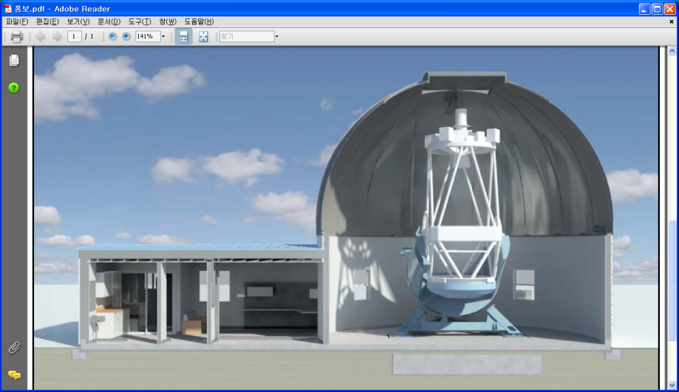
Buildings
Observing Dome
Ash Dome with 9.2m Diameter.
Air-Ventilation System
Overview of KMTNet Project in 2011
5th EACOA

Slide 29
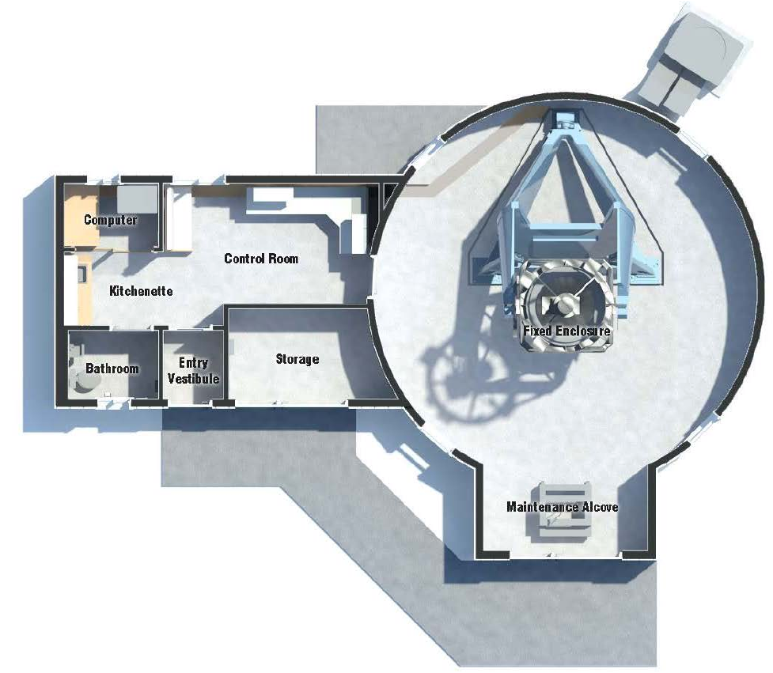
Buildings
Auxiliary Building
Control room
Computer room
Storage
Overview of KMTNet Project in 2011
5th EACOA

Slide 30
KMTNet Sites
KASI
SAAO
SSO
CTIO
Overview of KMTNet Project in 2011
5th EACOA

Slide 31
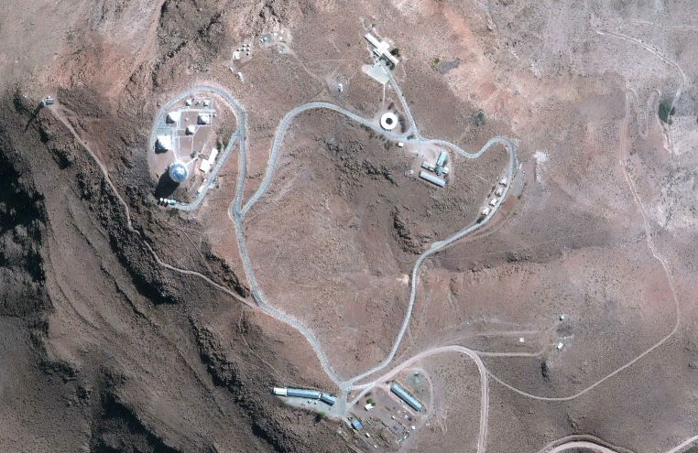
KMTNet Sites
CTIO
Overview of KMTNet Project in 2011
5th EACOA

Slide 32
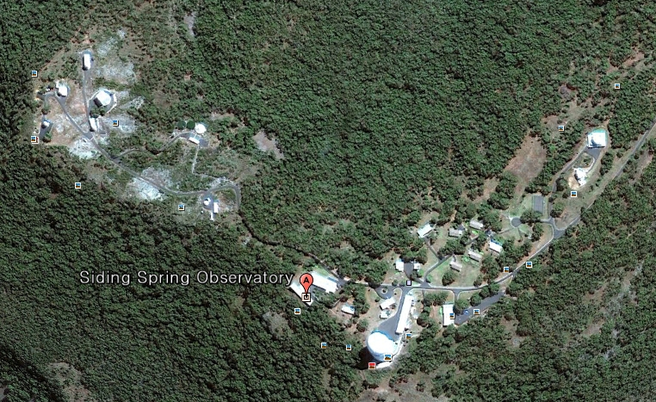
KMTNet Sites
SSO
Overview of KMTNet Project in 2011
5th EACOA

Slide 33
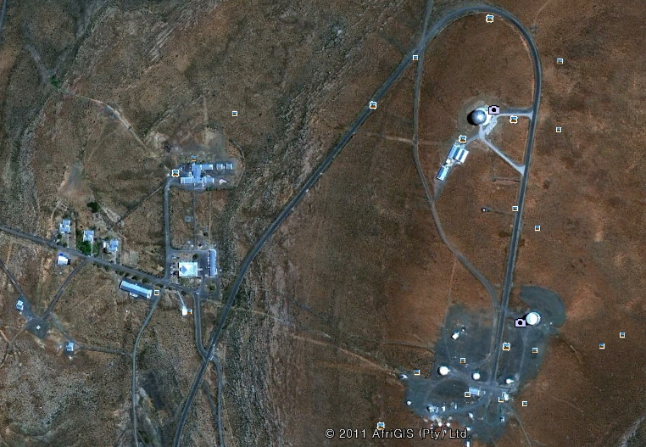
KMTNet Sites
SAAO
Overview of KMTNet Project in 2011
5th EACOA

Slide 34
Project Schedule
 | Development of the System
2009 | Concept Design of the Wide-Field Telescope and Mosaic Camera
Jul.2010 | Contract of the KMTNet Telescope
Mar.2011 | Final Design Completion of the Telescope
Jun.2011 | Contract of the KMTNet Camera & Telescope Manufacturing Start
Aug.2011 | Finish Polishing the First Primary Mirror
Dec.2011 | Final Design Completion of the Camera
Mid-2013 | First Light of the First System at CTIO in Chile
By Mid-2014 | First Light of the Second and Third Systems
Overview of KMTNet Project in 2011
5th EACOA

Slide 35
5th EACOA
Thank you!
Korea Micro-lensing Telescope Network
Korea Giant Magellan Telescope

